Slide 1
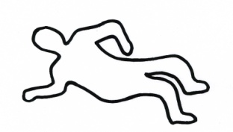
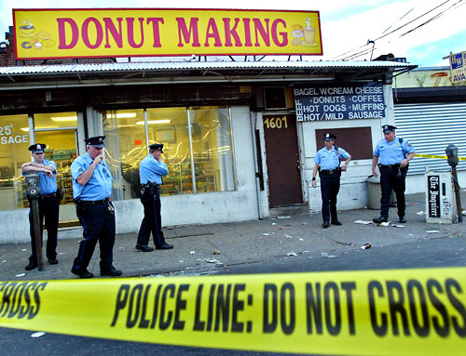
THE CRIME SCENE
“Oh, how simple it would all have been had I been here before they came like a herd of buffalo and wallowed all over it.”
—A. Conan Doyle, in The Boscombe Valley Mystery, 1892
Steven M. Falk Philadelphia Daily News
"Doughnut Crime Scene" It seemed interesting to me that these three elements came together at the same time: a crime scene, cops and doughnuts. Very ironic.
3 people shot 1601 Pratt in the 15th police district. Police at the scene of a doughnut shop on Pratt near Frankford. One of the 3 people might be the shooter.

Slide 2
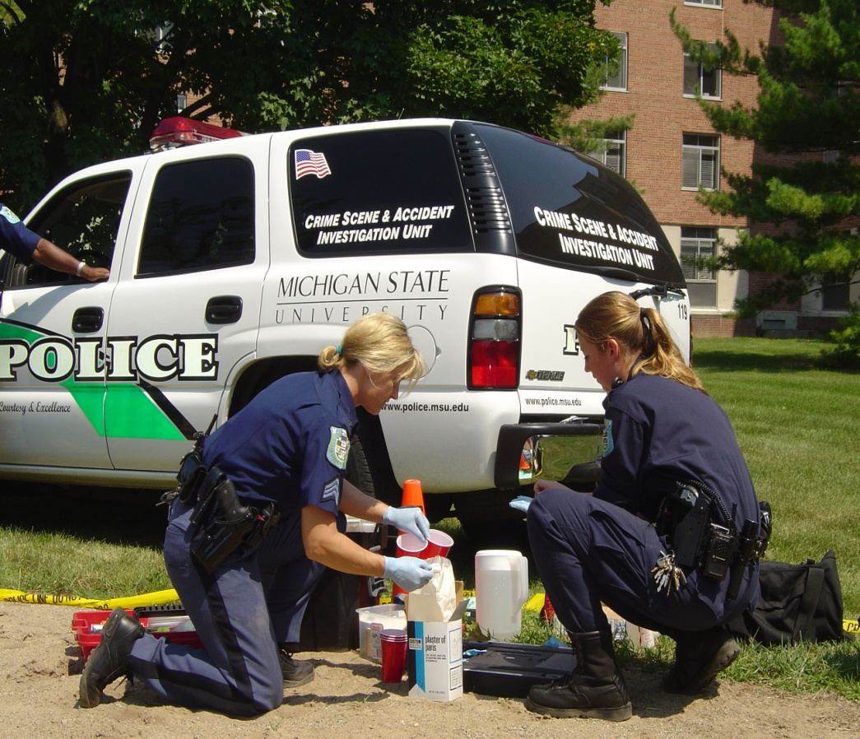
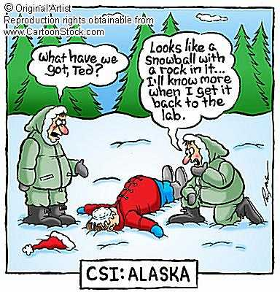
CRIME SCENE
R
Students will learn:
The steps to take when processing a crime scene.
That type of evidence determines what packaging should be used.
Why the chain of custody must be preserved.

Slide 3
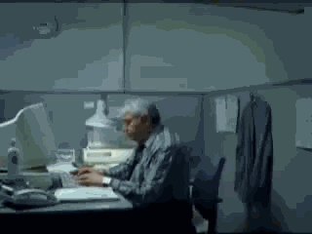
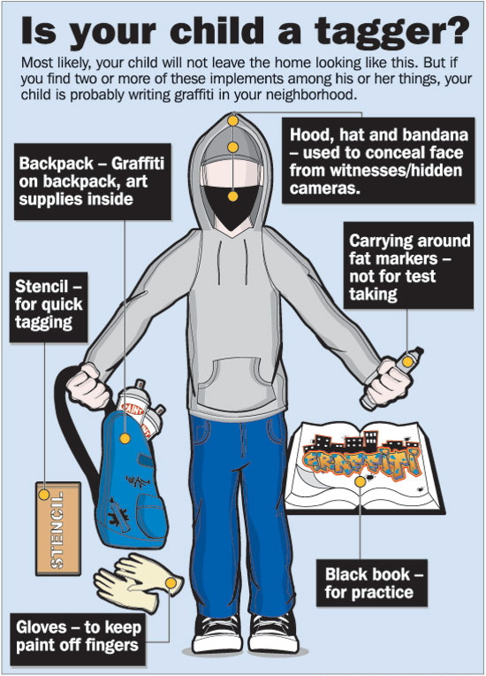
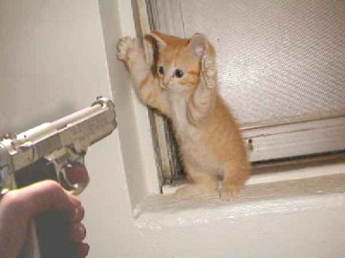
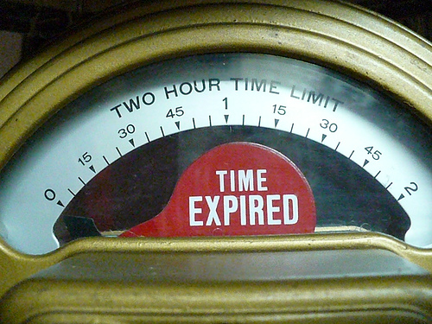
WHAT IS A CRIME?
A crime is the commission or omission of any act, which is prohibited or required by the penal code of an organized political state, to which some punishment or sanction is attached.
Classifications:
  Felony
    Punishable by death or imprisonment for more than one year in a state prison.
  Misdemeanor
    Punishable by fine and/or imprisonment for up to one year in a local or county jail.
  Infraction or Violation
    Minor offenses punishable by a fine only.

Slide 4
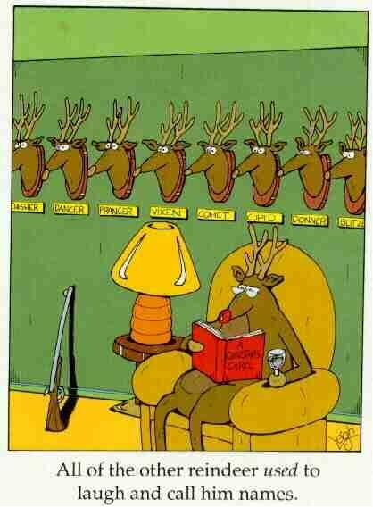
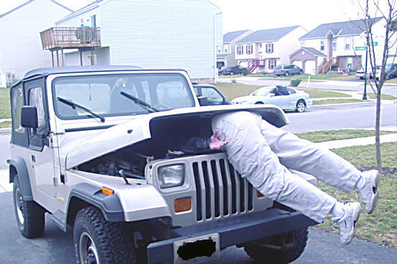
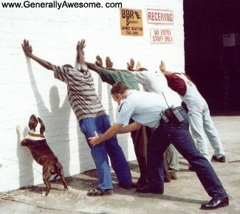
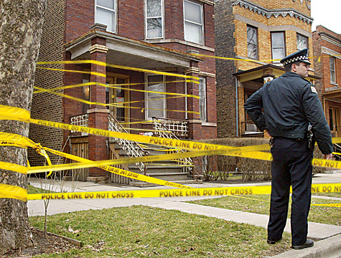

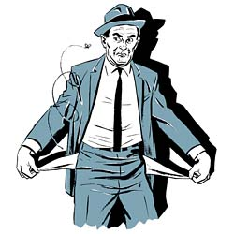
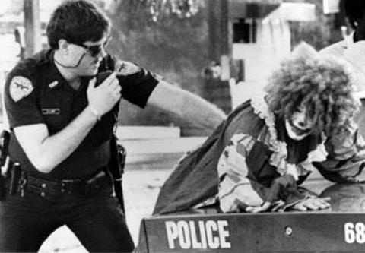
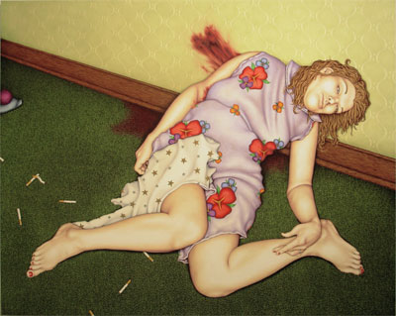
CORPUS DELICTI
“Body (essential elements) of the Crime”
  You must prove
  that a crime occurred
  that the person charged with the crime was responsible for the crime
Top Reasons for Committing a Crime
  Money
  Revenge
  Emotion—love, hate, anger
Source of Evidence
  Body
  Primary and/or Secondary Crime Scene
  Suspect(s)

Slide 5
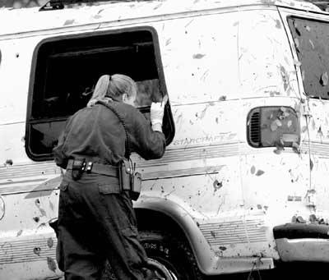
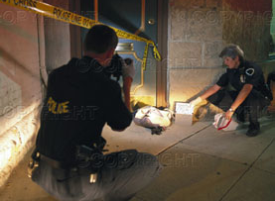
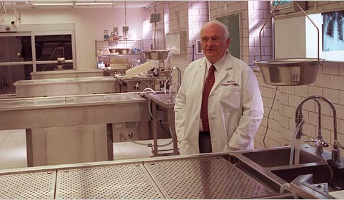
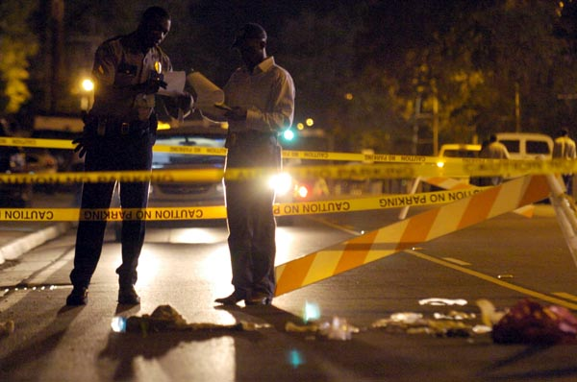

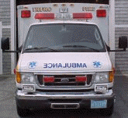
CRIME SCENE TEAM
A group of professional investigators, each trained in a variety of special disciplines.
Team Members
  First Police Officer on the scene
  Medics (if necessary)
  Investigator(s)
  Medical Examiner (if necessary)
  Photographer
  Lab Experts
1st official on scene is usually a police officer

Slide 6
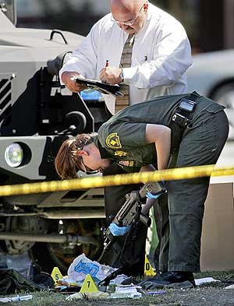
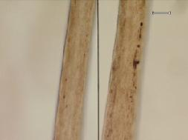
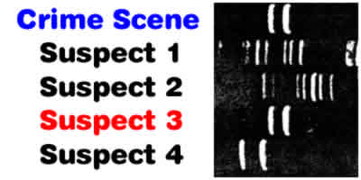
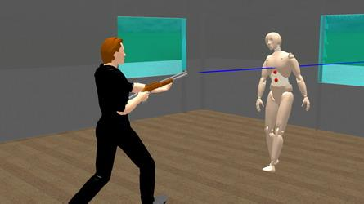
CRIME SCENE INVESTIGATION
Based on the scientific method,the Locard Exchange Principle, logic and forensic techniques.
Involves:
  Recognition—scene survey, documentation, collection
  Identification—comparison testing
  Individualization—evaluation and interpretation
  Reconstruction—reporting and presenting

Slide 7
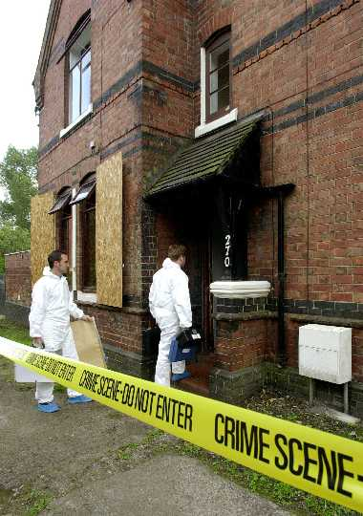
Defining the Crime Scene
Location of Criminal Activity
Primary = where the original crime occurred
Secondary = subsequent crime scenes
Let’s look at an example

Slide 8

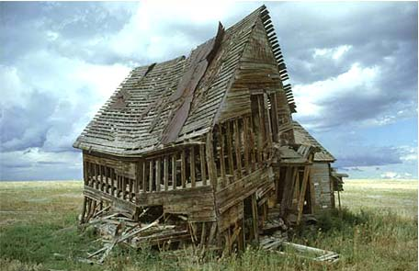
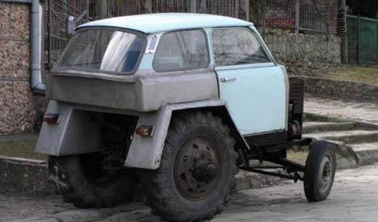
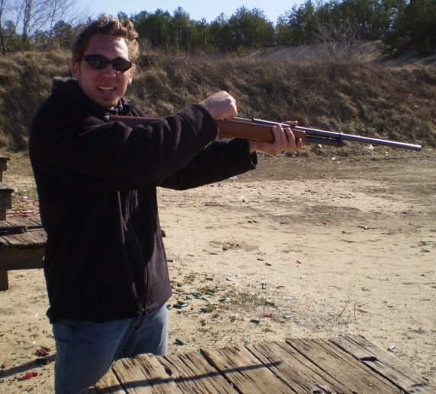
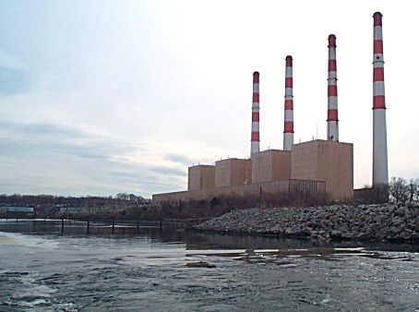
Primary vs. Secondary

Slide 9
Primary vs. Secondary
Primary Crime Scene

Slide 10
Primary vs. Secondary
Secondary Crime Scene

Slide 11
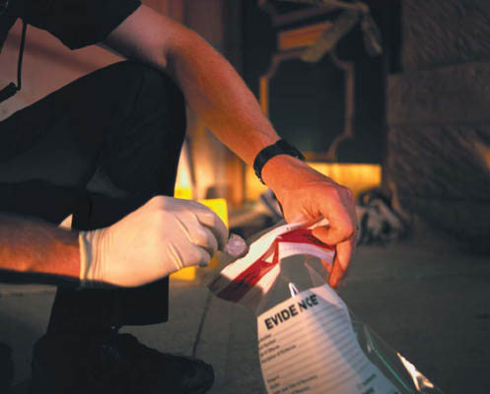
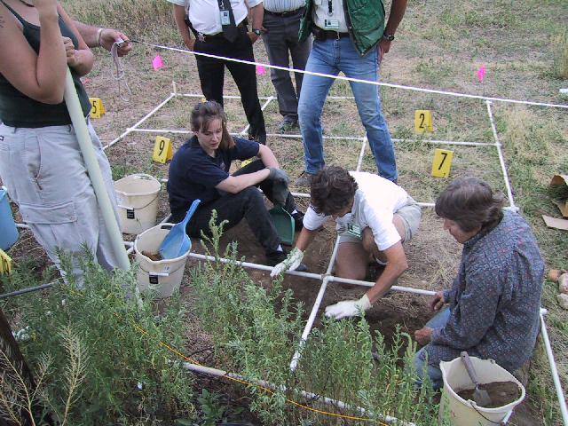
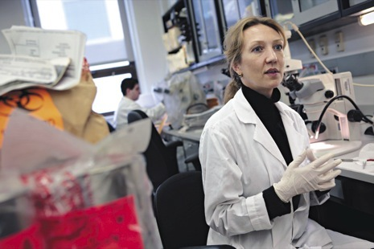
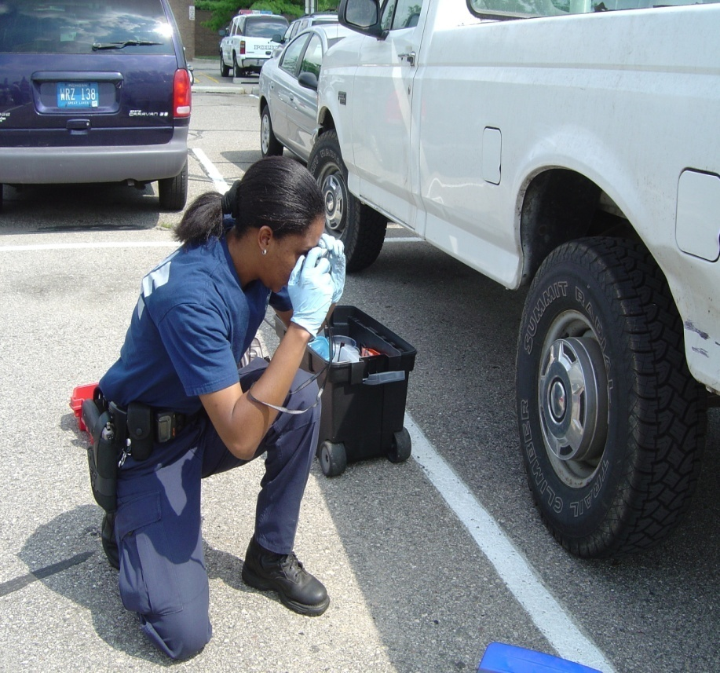
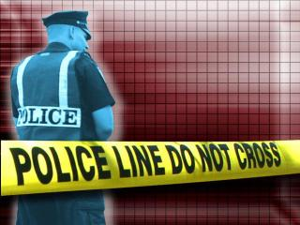
PROCESSING A
CRIME SCENE
Isolate and secure the scene
Document the scene
Search for evidence
Collect and package evidence, maintaining the chain of custody
Submit evidence to the crime lab
Lisa Faber, the supervisor of the N.Y.P.D. crime lab’s hair-and-fiber unit.

Slide 12
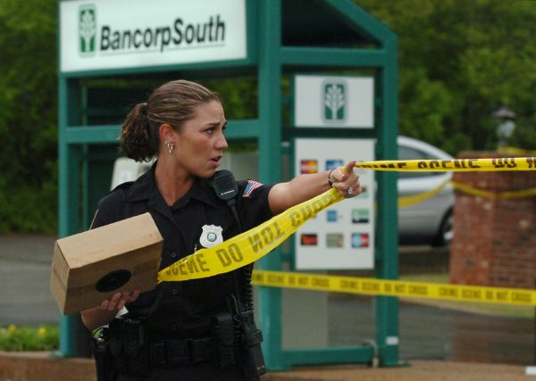
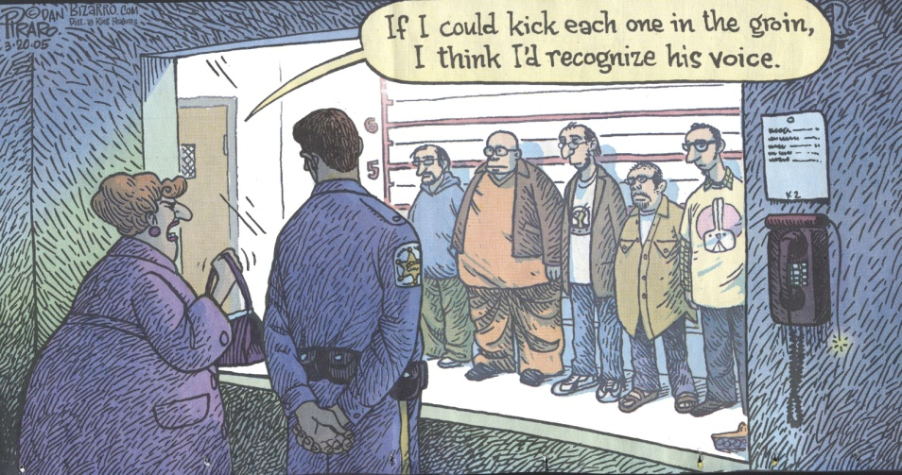
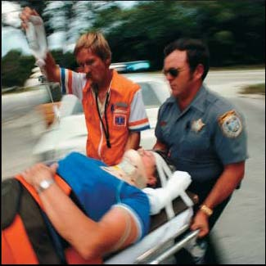
FIRST OFFICER
ON THE SCENE
A Assess the crime scene and assist those hurt
D Detain and separate the
witnesses (why?)
A Arrest the perpetrator
P Protect the crime scene
T Take notes

Slide 13
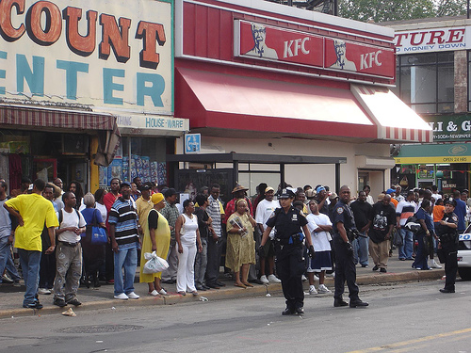
EVIDENCE PRESERVATION
A crime scene is no place for a crowd!

Slide 14
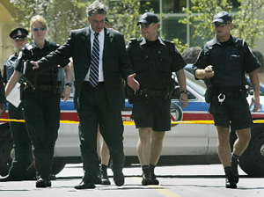
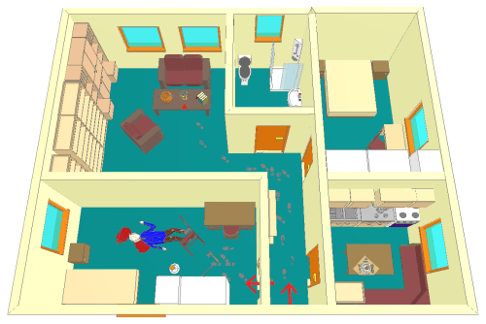
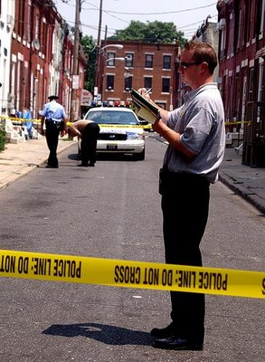
CRIME SCENE SURVEY
Walk-through—performed by the crime scene investigator, the first officer and sometimes the lead detective
Purpose:
  Mentally prepare a reconstruction theory
  Note any transient or conditional evidence that could change over time
  Note weather conditions
  Note points of entry or exit, as well as paths of travel within the crime scene
  Record initial observations of who, what, where, when, and how
  Identify special needs within the crime scene for personnel, precautions or equipment and notify superior officers or other agencies

Slide 15
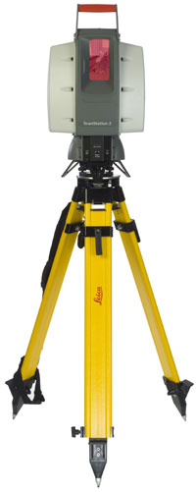
DOCUMENTATION
Notes—date and time, description of the location, weather and environmental conditions, description of the crime, location of the evidence relative to other key points, the names of all people involved, modifications that have occurred and other relevant information
Photography—photos of scene and surroundings, mid-range to close-up photos with various angles of each piece of evidence, photos as viewed by any witnesses.
Sketches—inclusion of date, time, scale, reference points, distance measurements, names of investigators, victims, suspects, and a legend (key)
Videography—allows narration (non-subjective) to be included
3-D Laser Scan —visually stunning rendering of the scene in 3D from which any measurement can be made and any perspective viewed, even long after the scene has been released. (Cutting Edge Technology!)

Slide 16
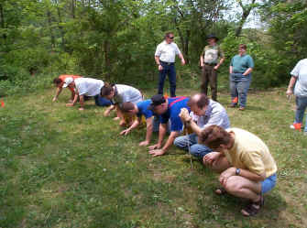
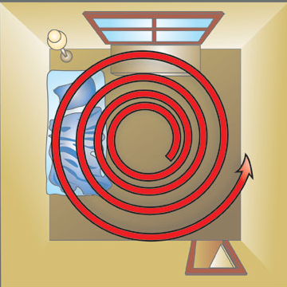
SEARCH METHODS
Line or strip method—best in large, outdoor scenes
Grid method—basically a double-line search; effective, but time-consuming
Zone method—most effective in houses or buildings; teams are assigned small zones for searching
Spiral method—may move inward or outward; best used where there are no physical barriers

Slide 17
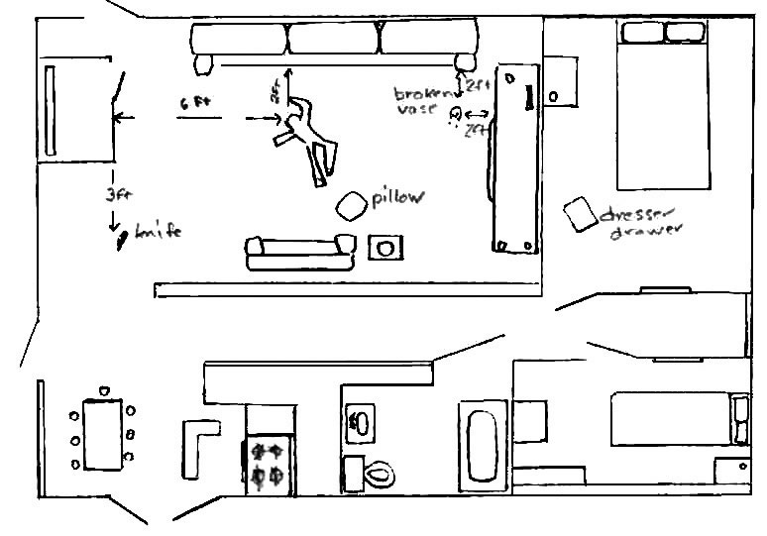
CRIME SCENE SKETCH
Date: August 14, 2005 Criminalist: Ann Wilson
Time: 11:35 am Location: 4358 Rockledge Dr, St. Louis, Mo.
N

Slide 18
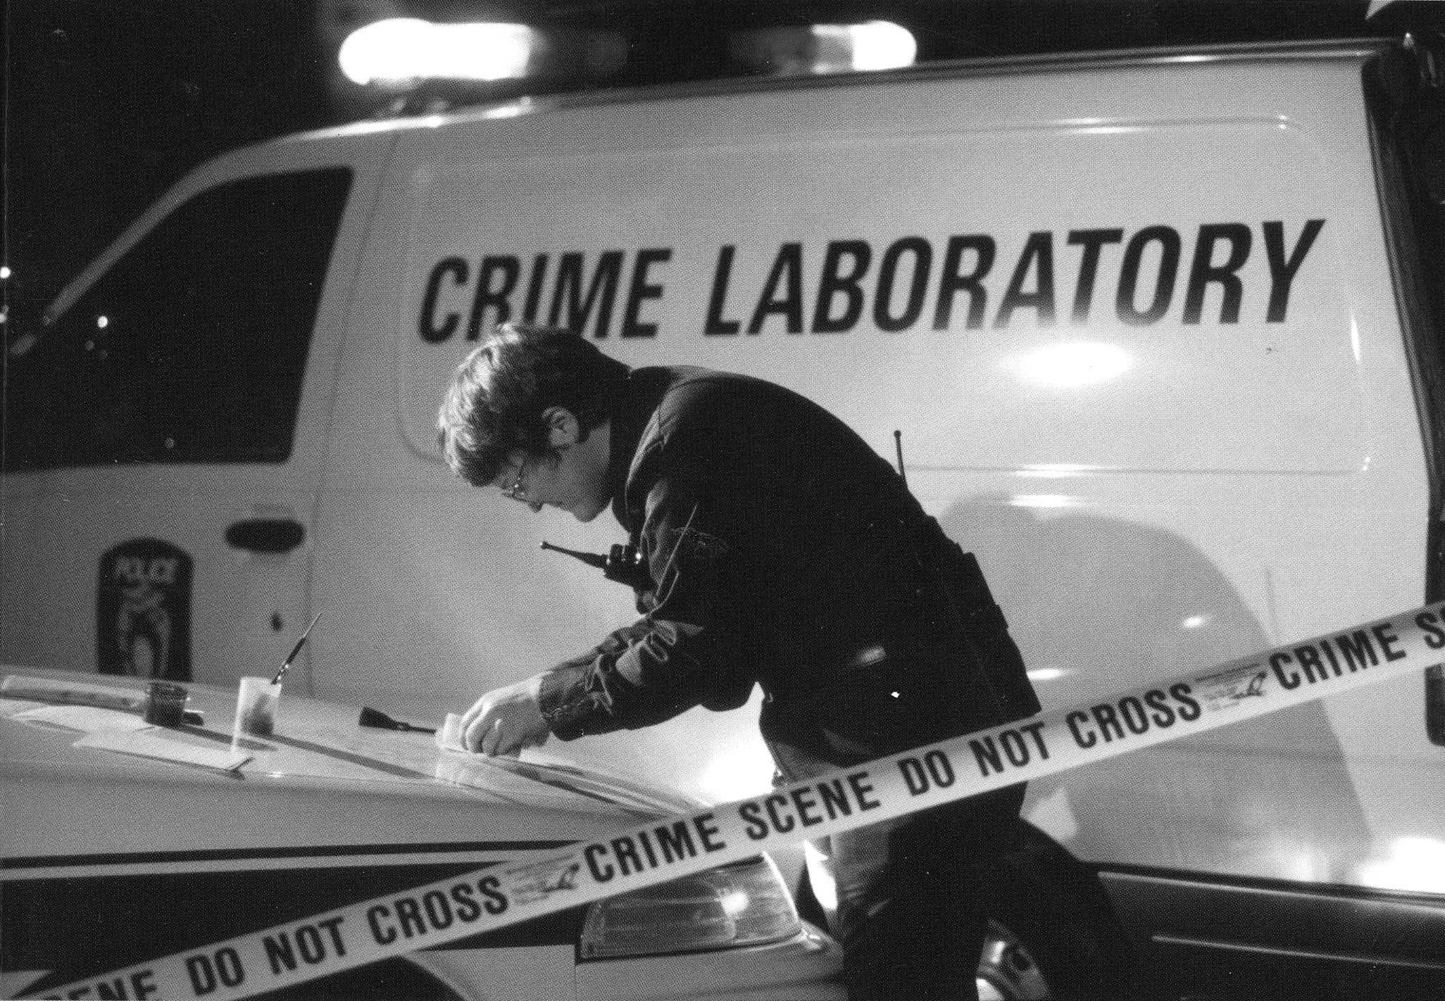
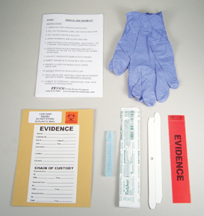
COLLECTING AND PACKAGING EVIDENCE
One individual should be designated as the evidence collector to ensure that the evidence is collected, packaged, marked, sealed, and preserved in a consistent manner

Slide 19
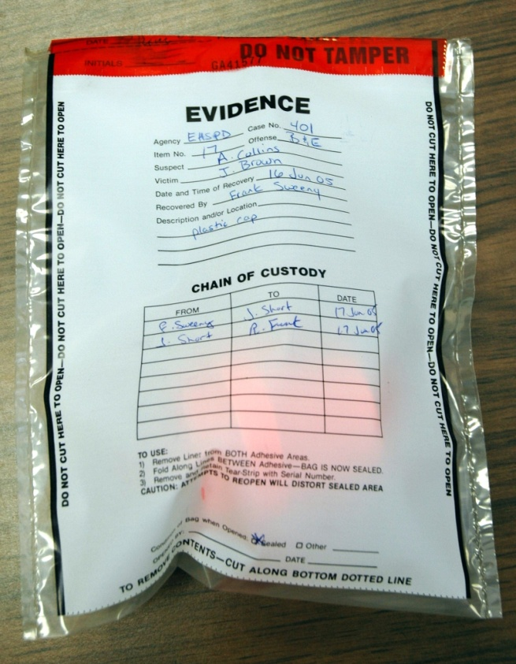
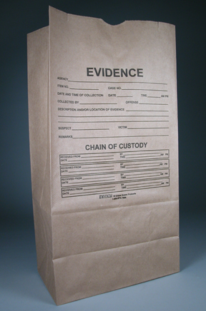
PACKAGING
Most items should be packaged in a primary container and then placed inside a secondary one. These are then placed inside other containers such as paper bags, plastic bags, canisters, packets and envelopes depending on the type and size of the evidence.

Slide 20
CHAIN OF CUSTODY
There must be a written record of all people who had possession of an item of evidence.
Why?
  The evidence container must be marked for identification
  The collector’s initials should be placed on the seal
  If evidence is turned over to another person, the transfer must be recorded.

Slide 21
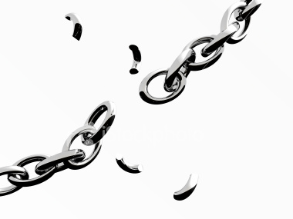



CHAIN OF CUSTODY
What will happen if the chain of custody is broken?
The court will not allow it to be presented during the trial!

Slide 22


Crime Scene Reconstruction
Initial evidence leads to the formation of Hypotheses (guesses as to what happened)
Hypotheses are tested by additional analyses
Disproved hypotheses are thrown out, leaving a reconstruction theory

Slide 23

CRIME SCENE RECONSTRUCTION
Stages
  Data collection
  Hypothesis formation
  Examination, testing and analysis
  Determination of the significance of the evidence
  Theory formulation
  (Scientific Method!)

Slide 24

CRIME SCENE RECONSTRUCTION
Censored

Slide 25



CRIME SCENE RECONSTRUCTION

Slide 26

CRIME SCENE RECONSTRUCTION

Slide 27

CRIME SCENE RECONSTRUCTION

Slide 28

Questions?

